Slide 1
What I want to do with NDN?
資工三 賴映岑

Slide 2
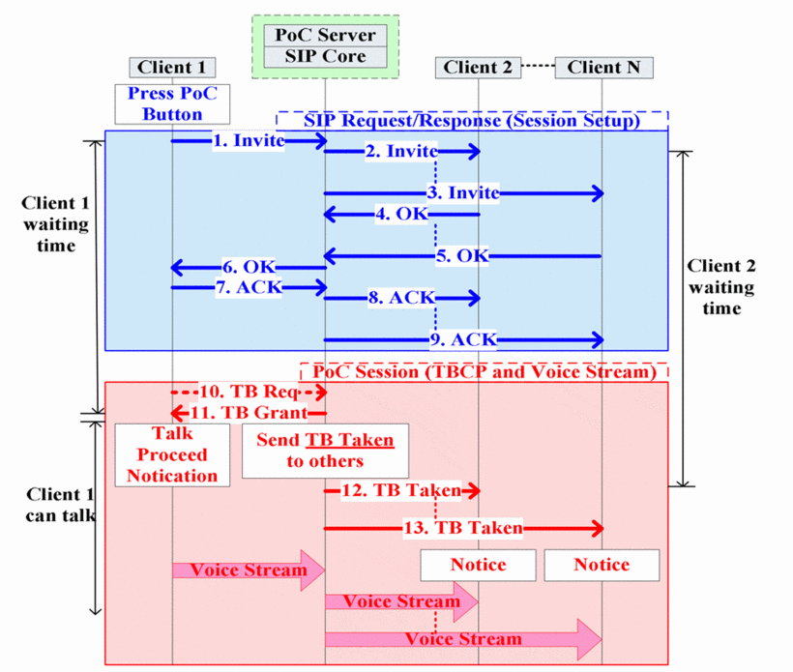
Push-To-Talk (PTT)

Slide 3
Push-To-Talk(PTT) on NDN
Use the same prefix to establish a group
Use NDN multicast for sending voice data
Multipath routing may decrease the delay

